Slide 1
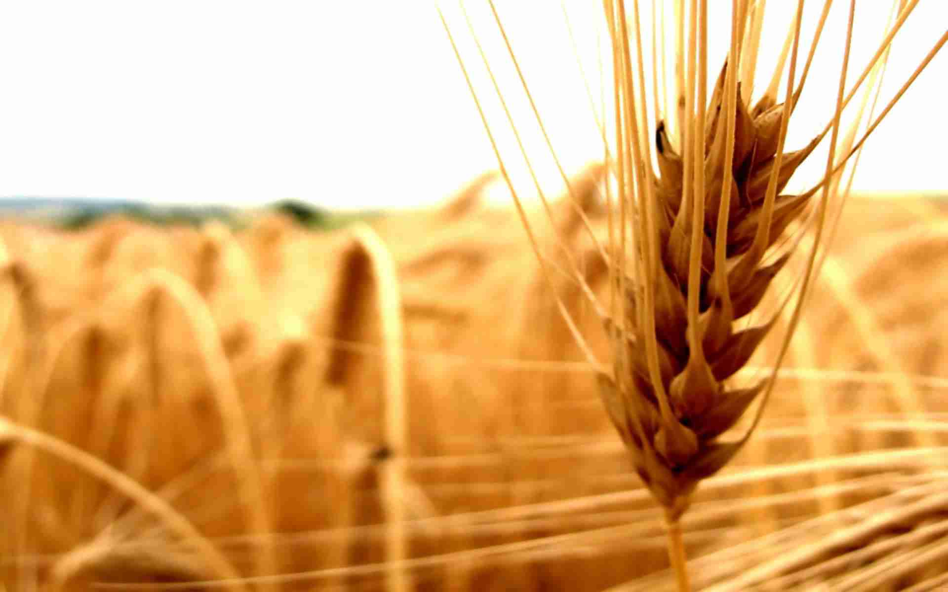



Introduction to Islamic Microfinance
Microfinance Center Uganda
3rd December, 19
Muhammad Zubair Mughal
Chief Executive Officer
Allhuda centre of Islamic banking and economics

Slide 2

Why Islamic Micro & Rural Finance?
Prohibition of Interest.
Approximately 46% conventional microfinance clients worldwide reside in Muslim countries
Tool of financial inclusion.
Asset Based Financing & Risk Sharing – Impact.
72% of people living in Muslim countries do not use formal financial services.
Development of Rural & Halal Industry.
SDG’s
Takaful ( Islamic Insurance)
Fintech
Economic Impact

Slide 3
Islam Agri. Finance & Shariah
Notes:
Source: Institute of Policy Studies

Slide 4
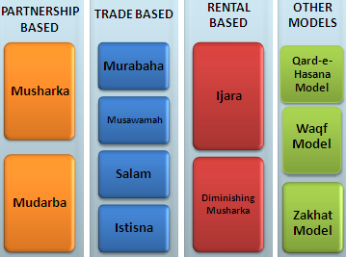
Source of Islamic Micro, Agri. & Rural Finance Products
Sources of Islamic Finance
Product Mechanism
  Quran
  Sunnah
  Ijma’a (jurist consensus)
  Ijtihad & Qiyas (analogy)

Slide 5
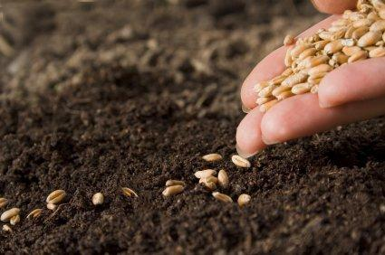
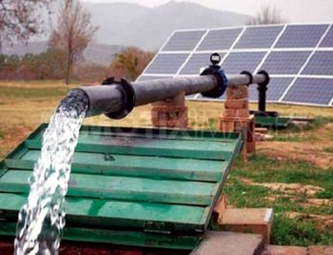

Islamic Microfinance Products
Murabaha – Cost Plus Sale
  Murabaha means a sale on mutually agreed profit, also known as cost plus sales, it is one of the most widely used instruments for short-term agricultural financing where the Bank/MFI undertakes to supply specific goods or commodities at mutually agreed profit to the client.
  Utilization :
  Murabahah can be utilize for Purchase of seed, fertilizer, harvesting and planting equipments, agri. Inputs, tractor, pesticides, farming goods, Solar Tube-wells etc.
  Currently Practiced:
  MBL and some other Banks, NRSP – KPK, Al Amal Bank, Islamic Bank Bangladesh,
  FINCA-AF, Islamic Relief, BMT’s in Indonesia etc.

Slide 6

Islamic Microfinance Products
Salam – Forward Sale
  Salam means a contract in which advance payment is made for goods to be delivered later on. The seller undertakes to supply some specific crop/goods to the buyer at a future date in exchange of an advance price fully paid at the time of contract
  Utilization
  Salam is ideal product for Agricultural Financing, through which a farmer can fulfill all the financial needs of the crop circle e.g. liquidity, seed, pesticide, fertilizer, harvesting, irrigation, market linkages etc.
  Currently Practiced:
  Wasil Foundation, Albarakah MPCS, MBL etc.

Slide 7
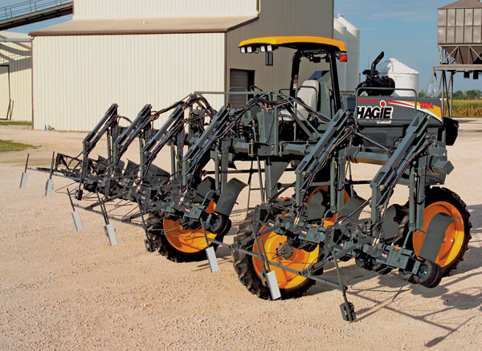
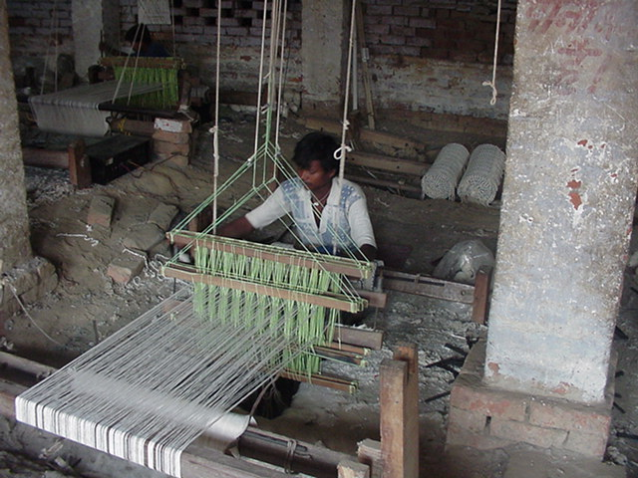
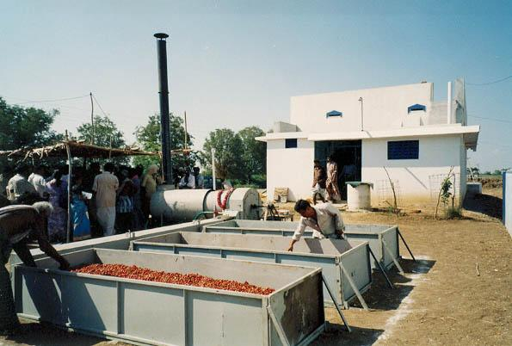
Islamic Microfinance Products
Istisna - Manufacturing contract
  A pre-delivery financing instrument used to finance projects where commodity is transacted before it comes into existence. It is an order to manufacture and payment of price, unlike Salam, it’s flexible, where price may be paid in advance, or in installments or on delivery of good.
  Utilization:
  Istisna May Utilize for small manufacturing Business, dairy or Agri. production, Construction of godowns and cold storage, Rural entrepreneur Development etc.
  Currently Practiced:
  AlBaraka MPCS, Ghana Islamic Microfinance bank,
  Alamal Bank, Bank of Khartoum etc.

Slide 8

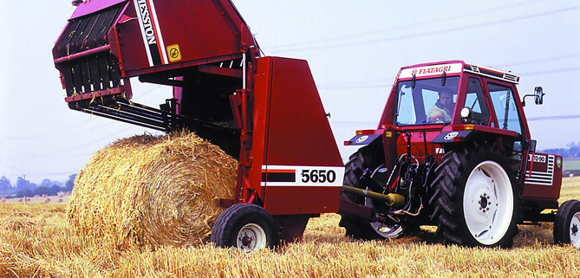
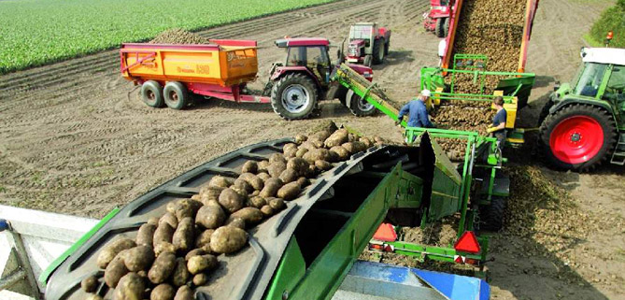
Islamic Microfinance Products
Ijara – Islamic Lease
Ijarah Means Operating lease. It is an arrangement in which the Islamic Bank lease Agri. equipments, Tractor & light vehicles, Agri. Instruments, buildings or other facilities to a client, against an agreed rental.
  Utilization :
Leasing of Tractors, Agri. Equipment, Threshers, Tub wells, small production unit lease, Sugarcane planter, Rice planter, harvesting vehicles etc.
  Currently Practiced:
  Al-Amal Microfinance Bank, NRDP, Wasil Foundation.
  Amanah Islamic Bank – Philippines.

Slide 9
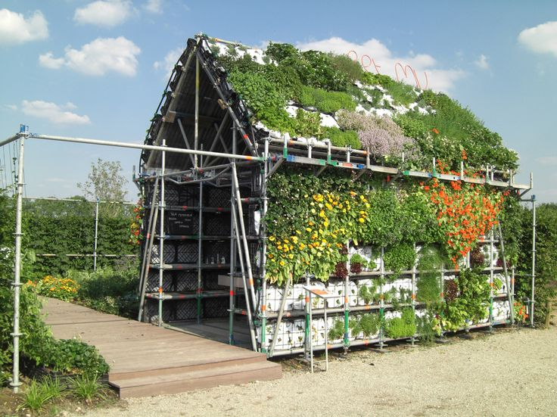
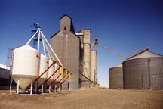

Islamic Microfinance Products
Diminishing Musharkah
  Diminishing Musharkah is a form of Musharakah where the Bank/MFI and the client participate in a joint commercial enterprise or property. This attains the form of undivided ownership of both, Over certain period the equity of financier is purchased by the client
  Utilization:
  It can be utilize for Rural housing, forest development, agri. Inputs, farming, sprinkler/drip/solar pumps, tube wells, Refrigeration vans etc.
  Currently Practiced:
  Islamic Bank Bangladesh, some Islamic banks etc.

Slide 10

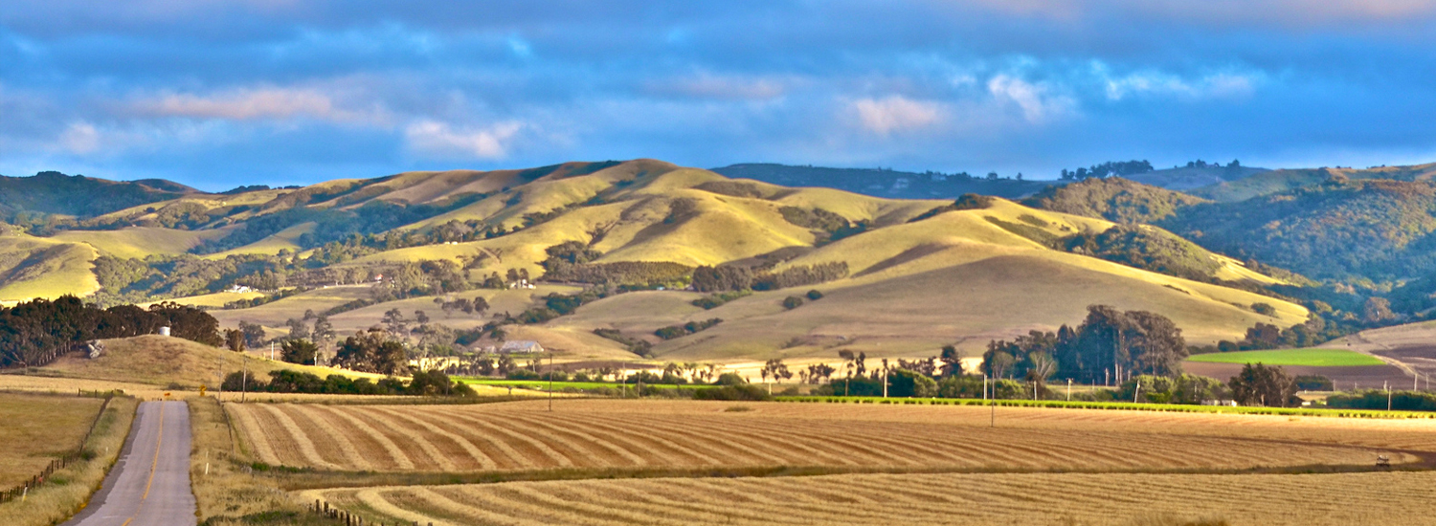
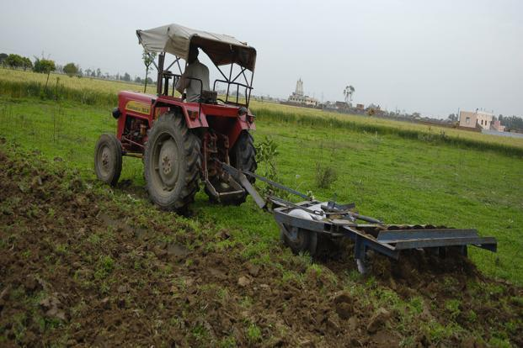
Islamic Microfinance Products
Musharakah & Mudarabah- Partnership
  Musharakah & Mudaraba means a relationship established under a contract by the mutual consent of the parties for sharing of profits and losses in the joint business.
  Utilization :
  Musharkah and Mudarabah can be used for Microenterprise & SME’S setup’s, Agricultural Joint venture projects, Dairy and livestock development etc.
  Currently Practiced:
  BOK, Amanah Islamic bank, AlBarakah MPCS etc

Slide 11
Islamic Modes – Agricultural Financing
Agricultural production Cycle - Crops
STAGE
ACTIVITY
Acquisition of land/
Choice of crop
Entering Contract of cultivation in
case of rented land, decision about crop
in view of market demand
Preparation of land
  Clearing, Leveling, Plowing, Seed bed preparation,
  Installation of Irrigation/drainage system
Crop production
operations
Sowing/transplantation, Irrigation, Fertilization,
Weeding, Pesticide application
Harvesting
    Cutting/ picking,
    threshing
Post harvest &
Marketing
    Cleaning, Grading, Processing, Packing,
    Storage, Transportation, Sale of produce

Slide 12
Islamic Modes – Agricultural Financing
Areas of Financing (including crop production)
  Working Capital (Short term):
    Crop production [Purchase of inputs i.e. seeds, fertilizers, pesticides, etc.] {Murabahah}
    Poultry Farming [purchase of feed/raw material, birds/chicks, vaccination/medication, utensils, etc.] {Murabahah}
    Dairy Farming [purchase and production of feed/fodder, milk container, vaccination/medication, utensils, etc.] {Murabahah}
    Fish Farming [purchase of fuel, ration, processing {Murabahah} equipment, purchase of handling and storage boxes, etc.]
    Liquidity Requirement [repair & maintenance of machinery & equipment, labor/water/utility charges, etc.) {Salam}

Slide 13
Islamic Modes – Agricultural Financing
Areas of Financing (including crop production)
  Term Financing (medium and long term:
    Farm Mechanization [Purchase of tractor and farm machinery for tillage, sowing/planting, pesticide application, harvesting/threshing, etc.] {Murabahah/ Ijarah}
    Transport [purchase of trailers, reefer vans, milk cooling/ chiller tanks/carriers, motorcycles/pickups, of feed/raw material, birds/chicks, vaccination/medication, utensils, etc.] {Ijarah/Diminishing Musharakah}
    Live stock [purchase/replacement of animals for milk & meet production, refrigerated storage, animal sheds, water supply system, generator, fencing slaughter house etc.] {Murabahah/DM/Istisna}
    Irrigation System [t/wells, sprinkler/drip/solar pumps, water course lining, etc.] {Ijarah/Murabahah/DM/ salam}
    Forest development and enhancement [nursery raising, tree plantation, etc.] {DM}

Slide 14
Islamic Modes – Agricultural Financing
Areas of Financing (including crop production)
  Term Financing (medium and long term:
    Poultry Farming [construction of breeding & hatchery farms, tools, feed mills, transport & distribution vehicles, slaughtering & processing, etc.] {Murabahah/ DM}
    Fish Farming/catching [construction of fish ponds & hatcheries, purchase/replacement of fishing boats, engines, and related facilities & equipments, construction of cold storage, etc.] {Murabahah/DM}
    Dairy Farming [milk processing, plants, etc.] {Murabahah/DM/Ijarah}
    Miscellaneous [green houses, godowns, dairy/livestock farms, seed/milk/fruits/vegetables processing equipment]

Slide 15
Market for Islamic Microfinance Products
Salam, Istisna and other products
MicroTakaful
Non-Poor
Transitory Non-Poor
Transitory Vulnerable
Qarz-e-Hasan, Murabahah, Ijarah, Mudarabah
Transitory Poor
Chronic Poor
Zakat, Sadqa, Ushar
Extremely Poor
Notes:
In this slide we will learn that what islamic Microfinance Product will be ideal for what sector, We can categories poverty into Six level
15

Slide 16
Factors to be considered while doing Islamic Finance
Poverty Alleviation Element
and more….
Moral
Ethical
Social
A Misconception removed
Islamic Microfinance is a system not the Religion, it can be utilized & operated by both Muslims and
Non-Muslim Communities for Poverty Alleviation, Social & Economic Development.
Micro Takaful
Islamic
Micro
Finance
Free from Gharar
Free from Interest
Financing
Shariah Compliants Funds
Ensure Shariah Compliance
Trainings & Quality HR
Shariah Vetted Products
Shariah Compliants Investments

Slide 17
Demand for Islamic Micro Finance
Research Studies by International Institutions.
Survey by | Surveyed Countries | Respondents Preference (%)
CGAP 08 | Jordan, Algeria, and Syria | 20% - 40%
PlaNet Finance 07 | West Bank and Gaza | 35% - 60 %
USAID 02 | Jordan | 24.9%
IFC/FINCA 06 | Jordan | 32%
Frankfurt School of Fin & Mgmt 06 | Algeria | 20.7%
IFC sponsored Study | Yemen | 40%
IFC 2007 | Syria | 43%-46%
Bank Indonesia 2000 | Indonesia (East Java) | 49%
AlHuda-CIBE | Pakistan (4 Districts) | 99%

Slide 18
Islamic Microfinance Institution Worldwide
Germany:2
- Muslim Society
Switzerland: 2
UAE: 4
- Dubai Islamic Bank
- Abu Dhabi Islamic Bank
- HSBC Amanah
UK: 5
- HSBC Amanah
- Muslim Aid
- Islamic Relief
Faith Matters
- The Halal Mutual Investment Company
Kuwait: 2
- Kuwait Finance House
United States: 3
Helping Hands
ISNA
Lariba
Bahrain: 2
Family Bank
Afghanistan 9:
- FINCA , WOCCU
- CHF
Ariana
Iran: 8
Pakistan: 11
India: 3
Bangladesh:9
Turkey: 2
- Faisal Finance Institution
- Ikhlas Finance House
Egypt: 3
- Alwatany Bank of Egypt
- Egyptian Saudi Finance
Malaysia: 11
2 - Pure Islamic Banks (Bank Islam, Bank Muamalat)
Rest - banks
Sudan: 13
Yemen: 05
Al- Amal
Al Kuraimi
South Africa
Awqaf SA
IMFI’s Worldwide: 300 * in Countries: 32
Market Size: 1 billion USD
Indonesia: 133
BPRS , BMT.
Muaritius
AlBaraka MPCS

Slide 19
Some Islamic Microfinance Institutions - Worldwide
Countries | Islamic Microfinance Institutions
Indonesia | BPRS, Islamic Financial Cooperatives referred as bait Maal wat Tamwil (BMT)
Bangladesh | Islamic Bank Bangladesh, Social and Investment Bank, Al-Fallah and Rescue
Afghanistan | FINCA (Qard Hasan), WOCCU, Ariana Financial Services , IFIC, etc.
Pakistan | Akhuwat , Farz Foundation, ASASAH, Muslim Aid, Islamic Relief, CWCD, ,HHRD , NRSP, NRDP, Naymet etc.
Malaysia | Amina Iftikhar, Tabung Haji etc
India | AICMEU, BASIX, Sahulat, Bait-un-Nasr , Al-Khair Co-operative, Marwar Shariah Credit
Egypt | Mit Ghamar Project
Syria | Sanadiq project Jabal al Hoss
Lebanon | Mu’assat Bayat Al-Mal
Yeman | Hodeidah Microfinance Program, Al-Amal Microfinance Bank etc.
South Africa | Awqaf South Africa
U.K | Faith Matters, Islamic Relief, Muslim Aid, HSBC Amanah etc.
Tanzania | Hajj Trust, Four SACCOS

Slide 20
Compatibility IMF Products with MF Models
Grameen Model: Amna Iftikhar – Malaysia, Islami Bank Bangladesh Limited etc.
Village Bank Model: Sanadiq program -Jabal al-Hoss, Syria, FINCA - Afghanistan etc.
Credit Union Model: Muslim Credit Union (Tobago), The Amwal Credit Union etc.
Cooperative Model: AlBaraka MPCS – Mauritius, Al- Khair Coop. – India, Muslim Community Coop.– Australia, Karakorum Cooperative Bank – Pakistan.
Self-Help Group: Aameen Society - India
For Profit Banks/MFIs Ghana Islamic Microfinance Banks – Ghana, HSBC Amanah – U.K, Bank Islami - Pakistan

Slide 21
Current Status of Islamic Finance Industry
Total market size2.6 Trillion USD with having 2000+ Islamic Financial Institutions
In 100+ Countries, among them 43 are Islamic and 57 are Non Islamic Countries.
250+ Takaful companies
750+ Islamic Funds are operating globally.
900+ Sukuk has been issued.
500+ Islamic Microfinance Institutions/Bank

Slide 22
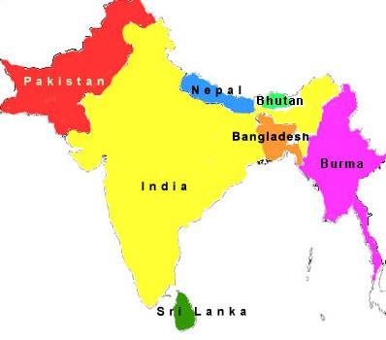
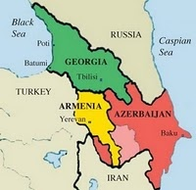
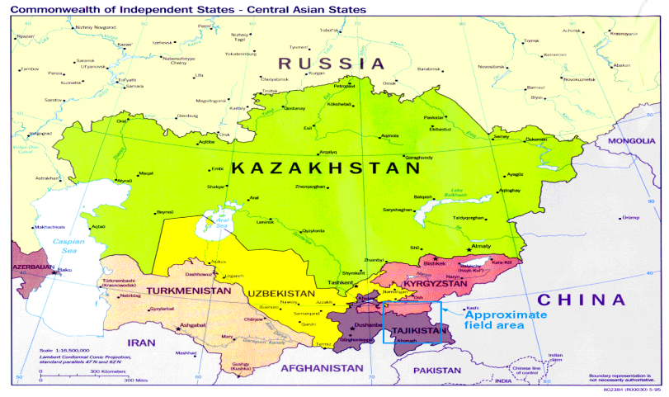
Need Assessment of Islamic Microfinance for
Central Asia, the Caucasus, and South Asia
Central Asia
South Asia
Caucasus
Countries | * Muslim Population | %
Kazakhstan | 8,887 | 56.4
Kyrgyzstan | 4,927 | 88.8
Tajikistan | 7,006 | 99.0
Turkmenistan | 4,830 | 93.3
Uzbekistan | 26,833 | 96.5
Aggregate | 52,483 | 85.5%
Countries | * Muslim Population | %
Bangladesh | 148,607 | 90
Bhutan | 7 | 1
India | 177,286 | 14.6
Maldives | 309 | 98.4
Nepal | 1,253 | 4.2
Pakistan | 178,097 | 96.4
Sri Lanka | 1,725 | 8.5
Afghanistan | 29,047 | 99.8
Aggregate | 536,331 | 33.2%
**Countries | * Muslim Population | %
Armenia | 1 | <0.1
Azerbaijan | 8,795 | 99.2
Georgia | 423 | 9.9
Stavropol Krai | - | -
Krasnodar Krai | - | -
Aggregate | 9,219 | 70%
* According to 2010-11 & .in figure 000 ** Appropriate data is not available for North Causasus
Notes:
Lets take a glimpse of Need Assessment of Islamic Microfinance for Central Asia, the caucasus and South Asia. In Central Asia we are seeing a big Muslim Popoultaion. In Central Asia………….
This concludes a great potential and requirement for Islamic Microfinance in these regions
http://en.wikipedia.org/wiki/South_asia
http://en.wikipedia.org/wiki/Central_Asia

Slide 23
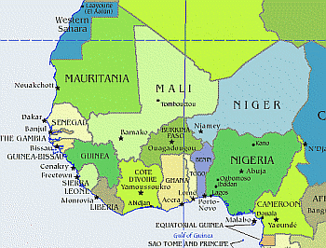
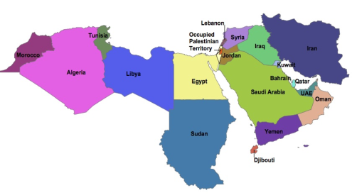
Need Assessment of Islamic Microfinance for
West Africa and MENA Region
West Africa
MENA Region
(Middle East & North Africa Region)
Countries | * Muslim Population | %
Benin | 2,259 | 24.5
Burkina Faso | 9,600 | 58.9
Cape Verde | < 1 | 0.1
The Gambia | 1,669 | 95.3
Ghana | 3,906 | 16.1
Guinea | 8,693 | 84.2
Guinea-Bissau | - | -
Liberia | 523 | 12.8
Mali | 12,316 | 92.4
Mauritania | 3,338 | 99.2
Niger | 15,627 | 98.3
Nigeria | 75,728 | 47.9
Senegal | 12,333 | 95.9
Sierra Leone | 12,333 | 95.9
Senegal Sierra | 12,333 | 95.9
Togo | 827 | 12.2
Aggregate | 171,485 | 57.8%
Countries | * Muslim Population | %
Algeria | 34,780 | 98.2
Bahrain | 655 | 81.2
Egypt | 80,024 | 94.7
Iran | 74,819 | 99.6
Iraq | 31,108 | 98.9
Jordan | 6,397 | 98.8
Kuwait | 2,636 | 86.4
Lebanon | 2,542 | 59.7
Libya | 6,325 | 96.6
Morocco | 32,381 | 99.9
Oman | 2,547 | 87.7
Qatar | 1,168 | 77.5
Saudi Arabia | 25,493 | 97.1
Syria | 20,895 | 92.8
Tunisia | 10,349 | 99.8
UAE | 3,577 | 76.0
Yemen | 24,023 | 99.0
Aggregate | 359,719 | 97.3%
* According to 2010-11 & .in figure 000

Slide 24
Need Assessment of Islamic Microfinance
Approximately 46% conventional microfinance clients worldwide reside in Muslim countries
Almost one-half of the 56 IDB member countries in Asia and Africa are classed as United Nations Least Developed Countries (LDCs),
Islamic Asset-based Financing – can prevent diversion of funds for consumption.
Islamic Microfinance have proven track record that its deals with long lasting & Complete solutions for Sustainability.
Halal Industry need funding for SME and Micro set-ups

Slide 25
Compatibility IF Products with Rural Credit lending Models
Grameen Model: Amna Itikhar – Malaysia, Islami Bank Bangladesh Limited etc.
Village Bank Model: Sanadiq program -Jabal al-Hoss, Syria, FINCA - Afghanistan etc.
Credit Union Model: Muslim Credit Union (Tobago), The Amwal Credit Union etc.
Cooperative Model: AlBaraka MPCS – Mauritius, Al- Khair Coop. – India, Muslim Community Coop.– Australia, Karakorum Cooperative Bank – Pakistan.
Self-Help Group: Aameen Society - India
For Profit Banks/MFIs Ghana Islamic Microfinance Banks – Ghana, HSBC Amanah – U.K, MBL-Pak.

Slide 26
Challenges
Non - Availability of Donor/Shariah Compliant Sources of Funds
Need to develop a uniform regulatory and legal framework for the Islamic Agricultural Finance.
Accounting & I.T systems., Rating Agencies.
Lack of Quality HR in Islamic Agri./Rural Finace Sector.
Standardization of Products.
Reluctance in Research & Implementation of new Products, as only (Murabahah) is serving almost 80% of Islamic Agri./Microfinance Industry.
Introduce new product line on the basis of Musaqa, Muzara’a & Mugharasa
Development of Shairah Expertise towards the Growth of Islamic Agricultural Finance.

Slide 27
Opportunities
IDB - Microfinance Development Program (MDP )
Islamic Microfinance Network (IMFN) for an effective interface and Coordination among IMFI’s
Supportive role of Govt. of Pakistan & SBP.
Expansion of Market where the Conventional Agri. Finance Products face limitations especially in Muslim Majority Countries
AlHuda Centre of Excellence in Islamic Microfinance is offering Services for the development of Islamic Agri. Finance Products
Islamic Banking and Finance is emerging in South Asia, Central Asia & MENA region which will strengthened the Islamic Agri. Finance products effectively.
Development of Fintech Industry.

Slide 28
Major Markets for Islamic Microfinance
Countries | Islamic Microfinance Institutions
Pakistan | Akhuwat , Farz Foundation, ASASAH, Muslim Aid, Islamic Relief, CWCD, ,HHRD , NRSP, NRDP, Naymet etc.
Afghanistan | FINCA , WOCCU, Ariana Financial Services , IFIC, Islamic Relief etc.
Indonesia | BPRS, Muslim Aid, Islamic Financial Cooperatives referred as bait Maal wat Tamwil (BMT) etc.
Yemen | Hodeida Microfinance Program, Al-Amal Microfinance Bank etc, Al Kurumi Microfinance etc.
Notes:
Here we have the country wise detail of some Islamic Microfinance Institutions worldwide.

Slide 29

Pakistan & Islamic Microfinance Industry
Innovation:
  Micro Takaful
  IT Integration (Mobile Banking) in Islamic Microfinance
  Livestock Product with Islamic Microfinance operation
  Micro energy & Micro Saving products
Challenges:
  Unavailability of Shariah Compliant fund
  Reluctance of Donor Agencies for Islamic Microfinance
  Accounting & I.T systems., Rating Agencies.
  Law and order in Northern part of Pakistan
Future Prospects:
  Rapid growth of IMFIs with high acceptability from the Muslim community.
  Govt. Interest and IDB Support
  AlHuda Centre of Excellence in Islamic Microfinance

Slide 30
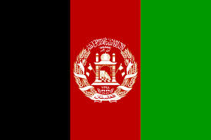
Afghanistan & Islamic Microfinance Industry
Innovation:
  Enterprise Incubation i.e. business modeling and micro financing.
  Integration of Rural Economy (Exact Target Market) with Islamic Microfinance
Challenges:
  Lack of Quality HR in Islamic Microfinance Sector Poor IT integration
  Weak microfinance regulatory regime.
  Unavailability of Micro Insurance
  Security, Law and order
Future Prospects:
  Rising Donors’ interest for poverty alleviation (FINCA, HIH, MISFA & USAID etc)
  High demand of Islamic Microfinance

Slide 31

Indonesia & Islamic Microfinance Industry
Innovation:
Bait-ul-mal Tamveel (BMT), BPRS
Challenges:
  Poor IT integration
  High Poverty Index
  Lesser financial sustainability in the community/ natives
Future Prospects:
  Rising Donors’ interest poverty alleviation especially through IMF
  Role of Ministry of Cooperative & Central Bank is positive.
  Rapid growth of IMFIs with high acceptability from the majority Muslim community.

Slide 32
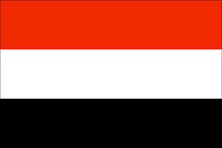
Yemen & Islamic Microfinance Industry
Innovation:
  I.T Integration & Micro Takaful
  Role of Islamic Bank to Strengthened the Islamic Microfinance Institutions.
Challenges:
  Reluctance in Research & Implementation of new Products, as only (Murabahah) is serving almost 80% of Islamic Microfinance Industry.
  Significant division of Urban and Rural population
  Law and Order
Future Prospects:
  High Demand of IMF
  Role of SFD & YMN
  New Range of Islamic Microfinance products

Slide 33
JazzakAllah
Thank you for listening with patience
Muhammad Zubair Mughal
Chief Executive Officer
AlHuda Centre of Islamic Banking and Economics
Zubair.mughal@alhudacibe.com
www.alhudacibe.com

